Slide 1
Skills Priority Statement
April 2021

Slide 2
Contents
Introduction
Greater Lincolnshire labour market: opportunities and challenges
Skills priorities for Greater Lincolnshire as a place
ESAP priority action plan

Slide 3
Introduction
This Skills Priority Statement serves for the ESAP and local partners as an interim statement, articulating where we are now and immediate actions we are leading and coordinating, ahead of a refreshed full skills strategy in Autumn 2021.
Labour markets are still in a state of flux as a result of the pandemic and we recognise that we will not know the true impact of current events on our workplaces and long term unemployment until at least the furlough scheme ends and perhaps some time after that. We do know that over the last 12 months we have witnessed changes in the use of digital technology and remote working, which were expected to take many years, and have instead happened in weeks. People and business that can, have adapted at a remarkable pace.
We also know that there are young people and adults who did not need to adapt because they were required to continue to work, or who have not been able to adapt. Lack of infrastructure to access a broadband signal, lack of funds to afford a connection and/or equipment, and lack of basic digital and literacy skills all play a part in that. To achieve our ambition, for residents to reach their potential in the local labour market and be able to participate in a flourishing and inclusive economy that will be increasingly digital, we all need to address these challenges.
Greater Lincolnshire has a population similar in number to Birmingham, spread across an area almost 20 times the size of Birmingham. A combination of Greater Lincolnshire's ageing workforce; an increase in automation; the unfolding labour shortages from EU migration that previously provided an additional pool of skilled workers from which to recruit; and eight Travel To Work Areas, creates a dynamic and complex set of inter-relating labour markets. It is impossible to predict every job vacancy that organisations will choose to recruit to but we can highlight where it is most needed and likely.
This report, along with The Pre-Covid SAP Analysis, provides further detail on persistent challenges and gaps in the local labour market as well as opportunities. Our aims for our local employment, skills and training agenda are to inspire and support young people to stay and work in the area, and to train and support people who are already working, or seeking jobs, so that they gain the skills needed to take up future job vacancies.
The Greater Lincolnshire Employment and Skills Advisory Panel
The Greater Lincolnshire Employment and Skills Advisory Panel (ESAP) was borne out of the Employment and Skills Board (ESB) and has a ten year history of bringing together employers with representatives of further education colleges, local training providers and universities to influence the predominantly nationally funded post-16, young people and adult skills and training system.
Directly, through its own programmes and indirectly, by informing and influencing others, it seeks to inspire and support young people to stay and develop careers in the area, and to support people in work, or seeking jobs, to gain the skills they need to take up and progress in future jobs.
The ESAP aims to provide the local ‘knowledge link’ and employer voice, to influence nationally designed schemes, and ensure that national learning and skills investment and funding is effectively delivered within Greater Lincolnshire.

Slide 4
Greater Lincolnshire labour market: opportunities and challenges

Slide 5
Labour market strengths and needs
 | Strengths | Needs
Labour demand | High skill opportunities in growth sectors – decarbonisation and offshore wind, advanced manufacturing, food production Growing demand in health and care professions Replacement demand opportunities in a range of sectors, occupations and skill levels | Overall skills shortages - 37% of vacancies hard to fill Higher level and technical resident skills needed in growth sectors Workforce development skills needed for small businesses Employability, digital and critical skills needs Replacement demand in food production, visitor economy and care for Brexit impact
Labour supply | Hotspots of higher-level skills in some areas Higher rate of health and care apprenticeship starts, growing before Covid-19 | Strategy needed to match demand to supply across large rural geography Need more residents with qualifications at level 4+ to meet growth sector future demand Need to boost apprenticeship starts to get young people into training and employment for the visitor economy, health and care, and growth sectors Support for those lower skilled and further from labour market to access opportunities through digital and employability skills Strategy needed for collaboration and investment to boost formal and employer training particularly across large rural geography Providers need to build higher-level qualification and vocational skills training for people upskilling, retraining, and who have had training interrupted by Covid-19

Slide 6
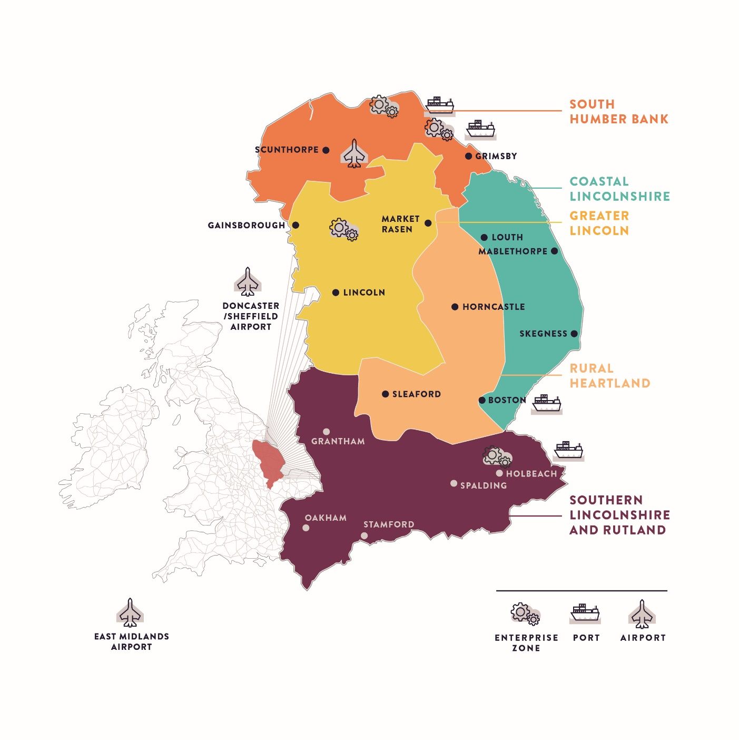
Opportunities
South Humber Bank
Strategic Opportunities: Decarbonisation & Offshore Wind, Ports & Logistics, Manufacturing & Engineering Food production
Assets: Two enterprise zones, two ports, Humberside airport, CATCH training centre, Humber Freeport, Grimsby and Scunthorpe TIPs
Challenges: Higher levels of deprivation
Coastal Lincolnshire
Strategic Opportunities: Visitor Economy, Health & Care
Assets: Mablethorpe, Skegness and Boston TIPs
Challenges: Deprivation inequality, aging population, poor access to skills provision
Rural Heartland
Strategic Opportunities: Visitor Economy, Health & Care
Assets: Lincolnshire Wolds AONB
Challenges: Rurality and sparsity, infrastructure
Greater Lincoln
Strategic opportunities: Defence, Manufacturing & Engineering, Health & Care
Assets: Access to two airports, enterprise zone, Joseph Banks Laboratories at the Science Innovation Park
Challenges: Deprivation inequality
Southern Lincolnshire and Rutland
Strategic opportunities: Agri-food, Defence, Visitor Economy
Assets: Enterprise zone, The National Centre for Food Manufacturing
Challenges: Significant inequalities in skill levels

Slide 7
Opportunities
Game Changers In our Plan for Growth, Greater Lincolnshire LEP has identified four game changer priorities relating to our growth cluster sectors. These game changers are areas we expect to boost growth and opportunities in our economic specialisms: UK’s Food Valley: ambition to deliver on 11,000 jobs and £2bn GVA by 2030 Humber Freeport: ambition to deliver on 7,000 jobs and £2bn inward investment by 2040 Clean growth plan development with Greater Lincolnshire LEP Energy Council to maximise offshore wind, decarbonisation, and hydrogen opportunities Defence and cyber security plan development supporting local RAF growth to achieve 2,500 jobs by 2030
One of the key drivers for the future success of our industrial specialism clusters and growth opportunities is skills development.
For decarbonisation and offshore wind, advanced manufacturing, defence, and where robotics automation is introduced in the food production supply chain, this means more people with higher level and specialist technical and digital skills and qualifications for sectors to grow locally. For example, it is forecast that 50% of future jobs in the food sector will require employees with level 4+ qualifications.
For some jobs in the visitor economy and food production, this means employability and critical occupational skills to employ local people where there are shortages created by migration out of Greater Lincolnshire.
The greatest number of job vacancies in the offshore wind industry is for project managers and electrical engineers, posts that repeatedly struggle to be filled in the Greater Lincolnshire area
We expect defence and security to grow in employment over the coming years, requiring high level skills.

Slide 8








Challenges
Rurality Greater Lincolnshire is a large, sparsely populated area with coastal peripherality and significant challenges for matching skills supply to demand and barriers to training: exacerbating recent fall in apprenticeships | Inequalities Across Greater Lincolnshire there are disparities in deprivation, skill levels, employment, wages and occupations between districts and the north and east coastal and south west |  | Replacement demand Over 2017-2027, the Greater Lincolnshire economy is forecast to need to fill 175,000 jobs. The vast majority (95%) will be due to people leaving the Greater Lincolnshire workforce, as a result of retirement and Brexit
Hard to fill vacancies 37% of vacancies are hard to fill, around two thirds of that total being due to skills shortages. Skilled trade sales and customer provision staff, with caring, leisure and other services staff, are most likely to be cited by employers as hard-to-fill. Critical skills and occupational training are needed | Lower skill levels 29% of the residents are qualified at NVQ Level 4+, compared with 40% nationally with geographic disparity: 44% in Rutland, compared with only 22% in North East Lincolnshire. 22% of the working population has low or no qualifications, rising to 30% in Skegness and Mablethorpe, compared with 18% in the UK |  | Impact of Covid-19 Almost a third of workers have been furloughed and claimant rates have almost doubled, exacerbating existing inequalities. Visitor economy profoundly affecting our communities. Training has been interrupted and needs digital skills
Impact of Brexit EU nationals have formed an important pipeline of workers in Greater Lincolnshire, particularly in food production and care. This presents a threat to some of the area’s key sectors such as agrifood and manufacturing and is a risk when healthcare is an important employment sector | Need for critical skills Critical employability, digital and literacy and numeracy skills are needed particularly in some of our towns and districts where unemployment and mobility challenges persist |  | Technical and higher level skills needed For our growth opportunity sectors and game changers, more technical and higher level skills will be in demand to work with new technologies and changes from automation
SMEs need workforce support Higher than average number of SMEs in Greater Lincolnshire, and many need HR and workforce planning support to plan recruitment, offer training, and provide structured work placements |  | Lack of inspiration and employer awareness about local career and skills opportunities Resulting in fewer graduates remaining in the area, and some inertia in post-16 and adult groups. A need to promote academic and vocational pathways linked to employers to inspire participation

Slide 9
Skills priorities for Greater Lincolnshire as a place
The following priorities build on those set out in both the Local Industrial Strategy and the Plan for Growth, as well as including updated priorities to address the present-day skills needs and challenges of Greater Lincolnshire.
These are priorities for Greater Lincolnshire as a place, some of which will be undertaken and led by the LEP and the ESAP, others of which will need to be led and implemented by a range of partners.

Slide 10







Skills priorities for Greater Lincolnshire
Maximising the impact of national employment and skills initiatives across Greater Lincolnshire
Supporting people with literacy and numeracy skills to improve their daily lives and the productivity of businesses
Informing our young people and adults about the careers available on their doorstep so that more are inspired to stay local
Upskilling and retraining people for jobs of the future including apprenticeships
Growing digital skills at all levels so that residents can reach their potential in the local labour market and participate in a flourishing and inclusive economy
Supporting businesses to prioritise workforce development and succession planning
Supporting important sectors to maximise the future opportunities for local people
The following priorities build on those set out in both the Local Industrial Strategy and the Plan for Growth as well as including updated priorities to address the present-day skills needs and challenges of Greater Lincolnshire.
These are priorities for Greater Lincolnshire as a place, some of which will be undertaken and led by the LEP and the ESAP, others of which will need to be led and implemented by a range of partners, reflecting the different responsibilities, resources, and powers of different partners.
By setting out these priorities collectively, however, we have an agreed statement on what our different activities will be aiming to achieve.
The skills strategy for Greater Lincolnshire will be undergoing a refresh in Autumn 2021 to reflect current context and issues. By refreshing the Greater Lincolnshire skills strategy, a wide range of partners can design approaches that help all residents to recover, retrain and upskill for work in growth sectors.

Slide 11




Maximising the impact of national employment and skills initiatives across Greater Lincolnshire
The polycentric nature and varied geography of Greater Lincolnshire leads to localised priority challenges. The ESAP will play an important role in supporting places in addressing individual needs.
Government's investments in the Kickstart and Restart programmes, and the promise of the Community Renewal Fund and UKSPF, are important to help Greater Lincolnshire's economy recover. It is important to ensure swift and effective local implementation of any government employment, training, and redundancy support schemes.
The sparsity of the population presents challenges in certain cohorts accessing (and therefore the viability of) employer-led and formal training. To address this challenge, essential infrastructure and capital assets that provide the resources for training and upskilling the workforce need to be delivered.
Supporting people with literacy and numeracy skills to improve their daily lives and the productivity of businesses
Literacy and numeracy skills in Greater Lincolnshire are below those seen nationally. Over half of residents aged 16-65 have numeracy levels at or below Entry Level 3, and 15% of the same population have literacy levels below Level 1, meaning they are unlikely to be able to read short messages or road signs. There is a need to upskill all residents in basic literacy and numeracy skills, in addition to focusing on digital or higher-level skills.
Upskilling these people will allow them to participate more fully in the local labour market, and research shows a significant correlation between productivity and the use of reading/writing skills.
Hence, the improvement in the proportion of the population employed in suitable jobs will not only improve peoples’ daily lives, but also result in a boost to productivity in the local economy.
Informing our young people and adults about the careers available on their doorstep so that more are inspired to stay local
The challenge of graduate retention is driven, in part, by an outdated perception among younger people that key sectors and the game-changer opportunities within Greater Lincolnshire do not offer sufficient career growth opportunities.
To meet the very high replacement demand within Greater Lincolnshire, younger people and adults need to be informed about the businesses, occupations, careers, and growth opportunities that Greater Lincolnshire can offer locally.
As part of this priority, the links between local employers or sectors, and job-seekers need to be supported and strengthened. Infrastructure and opportunities for job-seekers and employers to come together virtually and physically need to be developed.
Upskilling and retraining people for jobs of the future including apprenticeships
An ageing and retiring population across Greater Lincolnshire in addition to future job growth results in a high replacement demand across Greater Lincolnshire.
In order to stay competitive in the labour market, residents will need to retrain and upskill more often to meet future job demands, particularly in preparation for working with new technologies as part of IR 4.0.
Apprenticeships provide an important route into skilled employment for young people, and so it’s vital to build on the recent Apprenticeship Strategy and address the decline in numbers.
Notes:
This template was inserted from Power-user, the productivity add-in for PowerPoint, Excel and Word.
Install Power-user to access thousands of templates, icons, maps, diagrams and charts with Power-user.
Visit https://www.powerusersoftwares.com/
©Power-user SAS, terms of license: https://www.powerusersoftwares.com/terms

Slide 12



Growing digital skills at all levels so that residents can reach their potential in the local labour market and participate in a flourishing and inclusive economy
Although digital skills have long been seen as crucially important, the need for such skills to avoid social and labour market exclusion has been emphasised by the Covid-19 pandemic. There has been an increased preference for working, learning and engaging in commerce remotely on digital platforms, and many services have moved to digital by default.
Given the rurality and relative isolation of some parts of Greater Lincolnshire and the challenges this poses to skills provision more generally, the improvement of digital skills at all levels would be expected to improve access to learning across the board. This is potentially a major opportunity for Greater Lincolnshire residents, creating the chance to work remotely in professional services occupations which are not typically found in the area.
To maximise this opportunity, digital infrastructure (in terms of access to broadband and access to internet enabled technology in a rural area) will become increasingly important. Work needs to be undertaken to understand, promote and grow digital skills at all levels to enable residents to participate fully in society and take advantage of new ways of working.
Supporting businesses to prioritise workforce development and succession planning
Historically, there has been limited employer planning for the future workforce. Local employers have limited awareness of the local skills ‘offer’ and how it applies to their business.
Therefore, despite a higher than average proportion of employers providing training to employees (66%), the effectiveness of this training may be lacking.
Work will need to be done with businesses to prioritise workforce development, succession planning and recruitment strategies so that they can replace staff who retire.
This work will also help to overcome challenges around labour shortages as a result of Brexit. The objective is to increase good quality employment opportunities, whilst rapidly increasing the productivity of SMEs.
Supporting important sectors to maximise the future opportunities for local people
Greater Lincolnshire has a range of growing opportunity sectors and investments that need elements of skills investment or initiatives to support and enable growth.
Links between sector skills provision and strategically important schemes (such as the Freeport or Towns Deals) will need to be developed to ensure key sectors are able to maximise these growth opportunities.
As well as technical skills, managerial and specialist skill sets in Greater Lincolnshire are also in high demand as the area’s workforce who hold specific skills are retiring and cannot be easily replaced.
Work will need to be done with sector boards to articulate the specific skills needs of sectors and geographies to funders and providers of training.
Notes:
This template was inserted from Power-user, the productivity add-in for PowerPoint, Excel and Word.
Install Power-user to access thousands of templates, icons, maps, diagrams and charts with Power-user.
Visit https://www.powerusersoftwares.com/
©Power-user SAS, terms of license: https://www.powerusersoftwares.com/terms

Slide 13
ESAP priority action plan
While the previous slides highlighted the priorities for Greater Lincolnshire as a place, the following actions are priorities for the ESAP.
Collectively these priority actions aim to:
expand access to training and skills to every part of Lincolnshire, so that people can develop the skills that open up a lifetime of opportunity and fulfilling careers,
support local businesses to grow and thrive.

Slide 14
Skills action plan
Priority | Actions | Target group | Organisations involved in delivery | Timescales
Refreshing Greater Lincolnshire’s skills strategy | ESAP to submit the Local Skills Report containing labour market analysis and interim skills statement to DfE | Partners, service users and learners | Greater Lincolnshire LEP | April 2021
 | ESAP to develop a refreshed skills strategy for Greater Lincolnshire | Partners, service users and learners | Skills partners, providers and employers | June-October 2021
Maximising the impact of national employment and skills initiatives across Greater Lincolnshire | ESAP to feed local intelligence to Government around what’s working and not working on new skills and labour market support programmes | DfE SAP team | Greater Lincolnshire LEP | April 2021-ongoing
 | ESAP to deliver the skills capital schemes approved through the LEP's Greater Lincolnshire Skills Capital programme | Employers in Greater Lincolnshire’s priority sectors | Local colleges and skills providers | Up to March 2022
 | ESAP to influence delivery of ESF programme: including programmes through Co-financing partners ESFA, Big Lottery | ESF programme users: further from the labour market | ESF delivery partners | Until March 2023
Upskilling and retraining people for jobs of the future including apprenticeships | ESAP to update and publish the draft 2020 Apprenticeship Strategy and take forward actions | Employers and apprenticeship providers and people | Local partners, employers and apprenticeship levy payers | May 2021

Slide 15
Skills action plan
Priority | Actions | Target group | Organisations involved in delivery | Timescales
Informing our young people and adults about the careers available on their doorstep so that more are inspired to stay local | ESAP to continue the expansion of the Enterprise Adviser Network to include all secondary mainstream and SEND schools and Colleges across Greater Lincolnshire. | School aged and young people in FE and training | Employee Adviser Network | September 2021
 | ESAP to seek funding for and set up a Careers Hub in Greater Lincolnshire and demonstrate improvements against the eight Gatsby Benchmarks | School aged and young people in FE and training | Greater Lincolnshire LEP | March-September 2021
 | ESAP/LEP to manage the delivery of a programme of Online Jobs and Careers Fairs for 1 year until October 2021 | School aged and young people in FE and training | Greater Lincolnshire LEP | November 2020-October 2021
Growing digital skills at all levels | ESAP to follow up the recommendations of the Digital Skills Workshop | All residents, Users and learners | Greater Lincolnshire LEP | Ongoing
Supporting businesses to prioritise workforce development and succession planning | ESAP to seek funding for a HR and Workforce Planning Scheme that will increase good quality employment opportunities, whilst rapidly increasing the productivity of SMEs | SME employers | Local SME employers and businesses | April 2021-ongoing
Supporting important sectors to maximise future opportunities for local people | ESAP to support sector skills boards to develop skills priority statements that maximise future opportunities for local people, and focus on upskilling and retraining workers. | Employers and businesses in key sectors | Key Sector Boards | 2021

