Slide 1
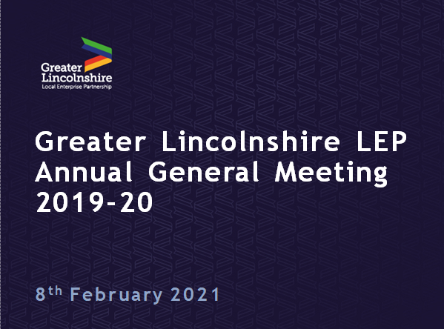

Slide 2
Pat Doody, Chair
Ruth Carver, Chief Executive
Notes:
Welcome to LEP company members to this years’ Annual General Meeting covering the financial year April 2019 – March 2020, but including more recent events and activity to provide further context. The focus will be on an overview of the company activity and finances which have been utilised in 2019-20 to deliver our ambitions. I will also be asking you at the end to vote on 3 resolutions:
The re-appointment of our Accountants
To adopt the financial position of the company
To adopt the amended Articles of Association

Slide 3
Covid-19 Pandemic
Increased business support
Protected key sectors
Shared intelligence
Shaped solutions & interventions
Building resilience
Notes:
The changes which we have all recently experienced will have a lasting impact. As the health and economic impact of Covid-19 unfolded last year, we quickly adjusted our delivery and programmes to ensure maximum support to the business community. The LEP ensured that local businesses continued to have access to the support and advice they need. Our expert advisers were in direct and regular contact with business owners, helping to protect our key sectors, sharing intelligence with government and helping frontline services source supplies. A significant volume of LEP resource and time since March last year has been redirected towards supporting the local and national Covid-19 response. I would also like to take this opportunity to thank Ursula Lidbetter who stepped down as Chair after 9 years’ service, for her time and commitment to the LEP since the start, and to thank directors, past and present for their unwavering vision, drive, passion, time and commitment. We are proud to be supporting businesses across Greater Lincolnshire during this challenging time.

Slide 4
Role of LEP’s
We support businesses to grow;
We set the aspirations for business opportunity, leisure, & learning;
We bridge local need with government funding;
We influence decision makers & investment choices;
We guide people to develop the skills businesses want;
We achieve results greater than our individual parts;
Notes:
However, our plans to deliver inclusive growth across Greater Lincolnshire remain strong and we continue to work with all partners locally towards the targets in our economic strategy and the emerging Local Industrial Strategy. In Greater Lincolnshire, our economy has historically proven resilient to negative economic shocks, and the crisis has already shown the resilience, spirit and adaptability of many of our businesses. Since 2010 we have been working with partners delivering transformational infrastructure, business support, and critical skills projects and programmes, resulting in strong foundations to drive prosperity through our £123m growth funding. Running parallel we have developed the Local Industrial Strategy for Greater Lincolnshire, which combined, remain central to recovery plans, with many interventions now being accelerated.

Slide 5
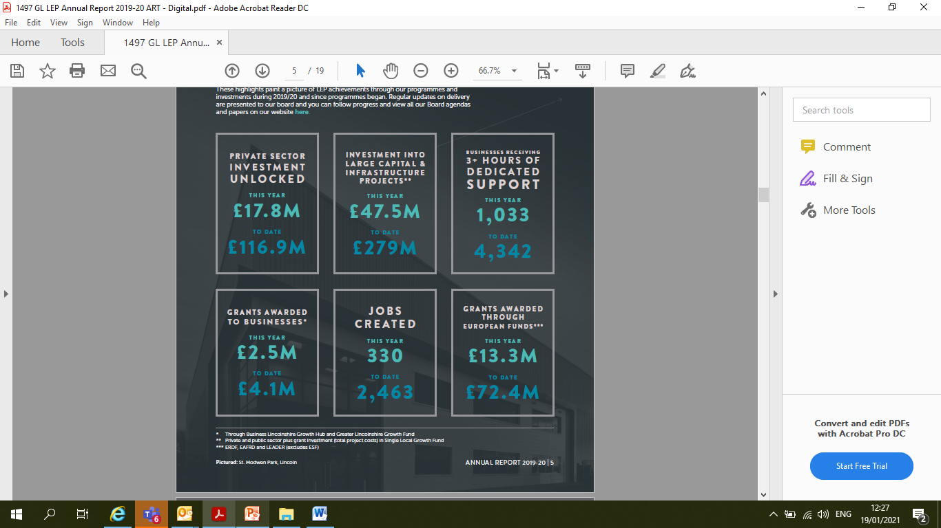
Achievements & Progress
Notes:
We have been focused on stabilising and transforming the economy by securing funds from government to help our businesses and support employment needs and many of our large transformational projects have completed or remain on track to complete. This slide gives highlights the progress made across a number of areas both in this financial year and to date. During the year we have also campaigned on behalf of Greater Lincolnshire for an enhanced focus on further education and employers in the education sector, more investment into broadband, and a stronger focus on coastal towns. We are very proud of the groundbreaking work we are undertaking to cement Lincolnshire’s reputation for food processing and automation, and have ambitious aspirations to become the national, if not a global lead for this. The Greater Lincolnshire Growth Fund was launched in October 2017 to support private sector businesses operating in the LEP's priority sectors and almost £3m of grant funding has been made this year. Individual sector development has accelerated particularly within the food, digital, and health sectors, with new advances also being made across defence and energy. During 2019 we extended the role of our Employment and Skills Board to include the responsibilities of the new national Skills Advisory Panel programme which ensures that local specialists are able to provide strategic advice on supply and demand for skills and qualifications and the expanded Enterprise Adviser Network brings together business leaders with local secondary schools to develop career and enterprise strategies and develops more effective ways of increasing the number of encounters and experiences young people have of employers and of work and we now have capacity to work with all secondary schools and FE colleges across Lincolnshire.

Slide 6
Highlights 2019-20
CAPITAL PROJECTS
Two Food Enterprise Zones
Agri-Food Centre of Excellence
Lincoln Medical School
Skills Capital Investment Fund
Scunthorpe Town Centre
South Humber Industrial Link Road
Gainsborough Growth Project
Grantham Southern Relief Road
Notes:
We are extremely proud of the rapid development of two Food Enterprise Zones, Europarc III, focusing on supporting growth of the existing seafood and value-added food processing cluster on the Humber, and the Holbeach FEZ laying important infrastructure for phase 1 of the South Lincolnshire Food Enterprise Zone. The Holbeach site hosts the Agri-food Centre of Excellence as a key partner, to include microbiology and chemistry laboratories, test kitchens, and seminar rooms, and will act as a world-leading innovation hub for advanced technologies such as robotics and automation ensuring our agri-food industry remains globally competitive. Another pivotal project is the Lincoln Medical School, a game-changing, high-quality integrated clinical facility which will drive skills development across the fields of medicine and allied health subjects to combine teaching facilities with innovation within a zero carbon building. Our Skills Capital Investment Fund was established to support capital projects that will result in an increase in the talent pool that employers can recruit from locally and an upskilled workforce within our priority sectors. Three schemes completed in 2019/20 are the Digital Skills Centre in Stamford College, supporing mobile technologies and green IT, the EMAT (Engineering, Manufacturing and Technology) Centre at Boston College, showcasing an industry-driven training facility for careers in the agri-food, engineering and manufacturing sectors; and the Technical and Business Skills Innovation Hub (University Campus North Lincolnshire) in Scunthorpe, supporting 1,858 new learners from this site. Infrastructure schemes include the South Humber Industrial Investment Programme Phase 2 Humber Link Road, essentially key road construction enabling access to employment and strategic connectivity; the Gainsborough Growth Project Phase 1, a major regeneration investment in Gainsborough including transport, town centre living, and plans for a cinema development; and the transformational Grantham Southern Relief Road Phase 2, a relief road bringing significant housing and employment opportunities and cementing Grantham’s position as a key sub-regional destination.

Slide 7
Highlights 2019-20
PROGRAMMES
Business Lincolnshire Growth Hub
Enterprise Co-ordinators
Coastal Communities Funded training
Team Lincolnshire Ambassador Programme
Notes:
The Business Lincolnshire Growth Hub is the business support arm of the LEP which offers fully funded, impartial advice to access business experts and mentors, support and guidance, grants and finance, to any business looking for support to stabilise, grow, and become more competitive. This year has seen the offer increased through three new Scale Up Workshop Programmes, tailored to the learning styles of the scale up businesses and the successful Interreg programme; COTEMACO (Collaborative robots within Agri-food/ Manufacturing environments). We worked with private sector partners to develop a Digital Hub (Mosaic) providing office accommodation, fixed desk options, co-working, meeting, and events spaces providing a fantastic facility and focal point for the digital community. Our main aims within the local employment, skills and training agenda is to inspire and support young people to stay and work in the area, and to train and support people who are already working, or seeking jobs, so that they gain the skills needed to take up future job vacancies. During 2019 we expanded our Enterprise Adviser Network bringing together business leaders with local secondary schools to develop career and enterprise strategies through more effective ways of improving work experiences for young people. In partnership with Lincolnshire County Council and district councils, two additional Enterprise Coordinators were recruited, enabling us to now work with all secondary schools and FE colleges across Lincolnshire. Our Team Lincolnshire Ambassador programmes is a vital part of driving forward investment and sector development ambitions and encouraging collaborative working amongst members and the public sector through events and promotion. They have already played a key role in collaborating together to rally support and to bring forward new schemes and sites across our region including the South Lincolnshire Food Enterprise Zone and Skegness Business Park. See the Annual Report for a full list and all projects and programmes on our website.

Slide 8
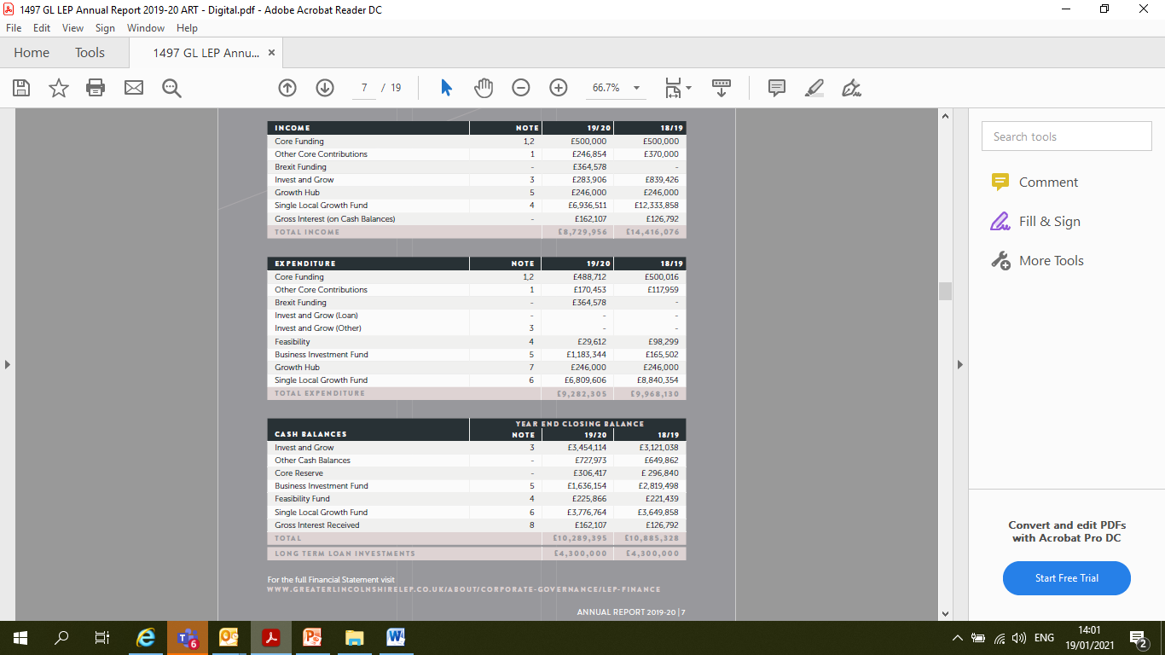
Financial Summary 2019-20
Notes:
The following section provides a summary of the financial position of the Greater Lincolnshire LEP from 1st April 2019 – 31st March 2020.
The LEP received £8.7million of funding within the year including its core funding allocation of just under £750k and the annual tranche this year for £6.9million of Single Local Growth Fund. Expenditure amounted to £9.2m.
Duncan & Toplis conducted an independent audit on LEP finances and presented their findings to our Finance & Audit committee stating that “No significant errors were found from our review of the financial reports for the year ending 31stMarch 2020 and the income and expenditure and cash balances held are consistent with the accounting records held.”

Slide 9
Core Funding
Total income received was £500,000
Actual expenditure outturn was £488,712
£250,000 match requirement of core funding exceeded
Match Funding
Board Directors’ Voluntary Time (Equivalent Value) | £ 47,277
Officer Support (Non accountable body) | £ 241,686
Consultancy Shared Service | £ 17,813
Events (Partner contributions) | £ 64,375
Notes:
The core income received in period was £500,000 and actual expenditure outturn for 19/20 is £488,712. The small underspend of £11,288 was placed on LEP Core Reserves. Other core contributions are ringfenced for specific spend such as the Enterprise coordinator grant. There is a requirement for the LEP to match fund £250,000 of the core budget with a further £250,000 of match funding. Analysis has shown that match funding this year of £371,151 has been evidenced, and has exceeded this target in supporting the delivery of the LEP core function, made up of the in kind contributions and other costs shown.

Slide 10
Single Local Growth Fund
PROJECT NAME | Single local Growth Fund
Boston Quadrant | 201,126
Grantham Southern Relief Road | 4,752,607
Unlocking Rural Housing | 100,000
Skegness Gateway | 526,934
Normanby Enterprise Park | 688,708
Agri-food Centre of Excellence | 511,680
Holbeach Peppermint Junction | 31,615
Lincoln Medical School | 4,477,500
Access to Employment Zones 2 | 664,682
Advanced Engineering R and D Centre | 157,790
Grantham Technology and Innovation Centre | 200,000
Gainsborough Growth Phase 2 | 25,000
Riseholme roundabout | 213,572
Huttoft | 14,657
Sleaford Growth Project | 134,175
Europarc Food Enterprise Zone | 822,406
DTLA | 375,853
South Humber Infrastructure Investment Programme Phase 2 | 775,413
Due diligence costs | 45,071
Total Programme | £14,718,789
Notes:
Single Local Growth Fund is our largest financial responsibility. At year end we currently hold contracts with an agreed grant contribution of £119,147,638. The LEP is 96.36% contracted against its total growth Deal allocation of £123,647,638. A remaining contract of £4.5million is in negotiation and it is expected to be signed as a deed in early 20/21. Within the year we received our fourth tranche of growth deal monies to the sum of £6,809,606. The table here shows how the monies were distributed across the growth deal projects. Over the financial year £126,905 was accrued to be paid back from the Hemswell Food Enterprise project following a withdrawal from the project applicant. These monies will be placed on the reserve once received in 20/21. £3,649,858 had previously been paid back from the withdrawal of the Grantham College project and Skegness Countryside Business Park. This reserve is expected to be used in future years against the current contracted projects. The Accountable Body on behalf of the LEP continues to monitor and report to board on freedom and flexibilities previously agreed on contracted projects. All decisions relating to these, were made by the LEP Investment Board and ratified by the Directors Board.

Slide 11
Other LEP funds
Invest & Grow (repayment) £ 283,906
Feasibility Fund (expended) £ 98,299
Greater Lincolnshire Growth Fund (expended) £ 1,291,346
Business Lincolnshire Growth Hub (expended) £ 246,000
Notes:
Other funds are listed here.
The balance as at 1st April 2019 was £3,170,208 (with applied interest). Loan interest received in period was £283,906. This resulted in an increase of the loan fund (not including cash balance interest to be applied in line with the Financial Interest policy) to £3,454,114.
Long term investment Loans as at 31st March 2020 amounted to £4.3m (£3.5m to Chestnut Homes to support the work of the Boston Quadrant scheme and £800k for The Lincolnshire Bomber Command) The total feasibility pot at the beginning on the financial year was £221,439 with £29,612 paid to contracts within the financial year. This was split into 2 distinct funds. During the financial year the LEP board agreed to increase the fund to £255,028 utilising cash balance interest resulting in the two funds realigned by 31st March 2020 and now are:
Feasibility fund committed £33,932
Feasibility fund commissioned £191,934
Since the launch of the Greater Lincolnshire Growth Fund in October 2017, there has been significant interest in the fund with 5 projects being approved and contracted. To date £1.3m of grant has been paid out to the contracts. Within the year Project management costs and £1.1m of grant payments have also been made.
The Greater Lincolnshire LEP secured £246,000 of revenue funding from BEIS to continue the operation of the Growth Hub service during 2019-2020.

Slide 12
Cash Balances
 | CASH BALANCES
Cash Balance 1 | Core Funding, Reserves and other cash balances | £1,045,993
Cash Balance 2 | Growing Places Fund (Invest to grow) | £5,373,043
Cash Balance 3 | Single Local Growth Fund | £3,870,358
The total cash balance as at 31st March 2020 held on behalf of the LEP by the Accountable body is £10,289,395.
Notes:
This slide shows the financial position of the LEP at year end, demonstrating that the LEP remains in a strong financial position. All interest has been applied in line with the cash balance and interest policies which are reviewed annually and any recommended spend ratified by Board. Any deposits held within the Council's cash balance, on behalf of another body or party is allocated interest at a daily average yield rate, compounded quarterly over the year. Total cash balances (including interest) are shown here, with the Accountable Body holding on behalf of the LEP a total cash balance of £10.2m.

Slide 13
LEP Directors
Pat Doody Alison Ballard Alric Blake Sarah Louise Fairburn Gary Headland Philip Jackson Craig Leyland Richard Metcalfe Mandy Watson | Yvonne Adam Debbie Barnes Colin Davie Dean Fathers Oliver Hemsley Zoe King Suraya Marshall Rob Waltham Nick Worboys
Notes:
Serving Directors during the period are detailed on page 6 of the Annual report under company information with the current Directors listed here. Within the financial year reported, Yvonne Adam, Alison Ballard, Suraya Marshall, Philip Jackson and Oliver Hemsley were appointed. Ursula Lidbetter, Herman Kok and David Dexter stood down, with Pat Doody replacing Ursula as Chair in March 2020 and Sarah Louise Fairburn replacing David Dexter as Deputy Chair. I’d like to thank both those who have moved on and those serving for their continued commitment and support, all members of our Strategic Advisory Boards, and the LEP Executive team along with all our partners and stakeholders.

Slide 14
Opportunity
Local Industrial Strategy focus:-
Food & food tech
Energy & water
Ports & Logistics
Defence
Health & Care
Visitor Economy
Geographic additions:-
Rutland
North & North East Lincolnshire
Notes:
Greater Lincolnshire is a £20.7bn economy, with (pre-Covid) ambitions to add £3.2bn to GVA by 2030. Our LEP Recovery Plans are now in place and alongside the adjusted Local Industrial Strategy, give much cause for cautious optimism. The Local Industrial Strategy identifies the following strengths; Agri-food; Energy and Water; Ports and Logistics; Defence; Health and Care; Visitor Economy.
A collaborative effort is needed to continue to raise the profile of our economic, natural, and social capital. We have in place an enviable network of partnerships and relationships built between private and public sectors, educators and innovators, government and MPs, and can demonstrate unique opportunities across many established and new sectors. By building on the strong foundations already in place, and identifying our area’s distinctive strengths, opportunities and challenges, we are creating a more resilient economy. We recently welcomed fully both North and North East Lincolnshire into the LEP family, alongside Rutland as a new geographical addition, all three bringing with them new and exciting opportunities through the clean energy, petrochemical, and tourism sectors, and we are confident that we can continue to bring the best opportunities to our businesses, residents and young people.

Slide 15
Articles of Association
Summary of proposed changes:-
Incorporating the new LEP Geography
Reducing the number of public sector directors in line with the LEP's Assurance Framework
Changing boards to Strategic Advisory Board (sub-board) throughout
Notes:
The Articles of Association have been amended with proposed changes required to address the amended geographical boundaries, government targets for increased private to public sector balance, and clarifying the company boards by re-terming the strategic advisory boards as ‘sub-boards’. Changes are minimal and company members will be asked to vote the new version in the resolutions at the close of this meeting.

Slide 16
Resolutions
To re-appoint the accountants of the company for the financial year 2020-21
To receive and adopt the accounts of the company for the accounting period from 1st April 2019 to 31st March 2020
To adopt the amended Articles of Association
Notes:
We now move to resolutions:
All those in favour of reappointing Streets Accountants?/ All those against?
The resolution is carried in favour of xxxxx
All those in favour of adopting the Accounts of the company 2019-20? /All those against?
The resolution is carried in favour of xxxx
All those in favour of adopting the amended Articles of Association? /All those against?
The resolution is carried in favour of xxxx
We have completed the LEP AGM for the year 2019-20. Any questions, please contact myself or other officers here today. So thank you and the meeting is now CLOSED.
NB: Directors are no longer able to vote and we need 5 members to be quorate with at least one private and one public sector member present or by proxy.

