Slide 1
The next generation of work experience and career insights

Slide 2
About The EBP
Developing the skills of young people
Natwest SE100 company
Well established Education Business Partnership (20 years trading)
Support young people across all key ages and phases of learning
Our Services
Work Experience – supported over 50,000 young people
Schools Programmes – resilience, careers and STEM
Adult Learning – ESF funded provider
National Citizen Service (NCS) – prime provider in
East Midlands for 8 years

Slide 3
The Challenge for Work Experience
Covid Related Challenges
Social Distancing Measures
Closure of Schools
Businesses with competing priorities
Legacy Challenges
Young people and employers constrained by geography and/or costs
Not always all-inclusive
Placements are often expensive
Health and safety implications restricting access
to sectors and careers

Slide 4
The Solution
The first programme of its kind nationally
Discover Reality comprises of three elements;
Discovery
Journey
Reality
It is an innovative and trailblazing service leading the way on how
young people access meaningful career insights in the modern world

Slide 5
Discovery
VR experiences
POV footage of real roles in real businesses
Journey
Employment pathways
HE & FE Opportunities
Reality
Engagement with professionals
Leading to work placement

Slide 6
School Benefits
Experience a wide variety of sectors from the classroom
Supports schools to meet Gatsby Benchmark 6 and 7
No barriers to access
Accessible during COVID-19
Cost effective
Flexible

Slide 7
Supporting Organisations – Confirmed

Slide 8
Supporting Organisations – In Pipeline

Slide 9
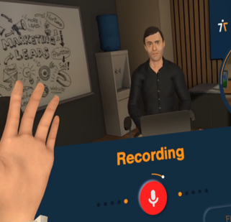
Evolving Discover Reality
Introducing Discover Reality Experiences
Interview Simulator
Work Experience Simulation
Plus many more to come

Slide 10
Thank you for your time
Q&A

